Slide 1


ADVANCED PROGRAMMING · FINAL CASE STUDY
Car Price Prediction Model
Training a regression model on ~99,000 real UK used-car listings to predict price from specifications
SRH Berlin University of Applied Sciences · M.Sc. Big Data & Artificial Intelligence · Group 5 · 28 July 2026
Notes:
Good morning everyone. We're Group 5, and our final case study is a Car Price Prediction Model. Our goal is simple to state: given a used car's specifications — its year, mileage, brand, fuel type, transmission and engine size — can we predict its price? We built a full machine-learning pipeline on around 99,000 real UK listings. I'll start with the introduction and the data, then hand over to the team.

Slide 2







Presentation Roadmap
Five sections, four presenters — one continuous flow from problem to solution.
01
Project Introduction
The problem, motivation and objectives
02
Dataset Overview & EDA
Source, features and exploratory analysis
03
Methodology & Implementation
Preprocessing, feature selection, models
04
Results & Discussion
Model comparison and what drives price
05
Conclusion & Future Work
Key takeaways and next steps
Group 5 · Car Price Prediction Model
2

Slide 3
UP NEXT · PART 01
Project Introduction
01
Why used-car pricing is a real problem — and what we set out to build.
Notes:
Let's begin with why this problem matters and what our objectives were.

Slide 4




Project Introduction
The Problem
Our Objectives
Pricing a used car is genuinely hard. Its value depends on many interacting factors — age, mileage, engine size, fuel type and brand — and no single rule captures them all. Buyers risk overpaying and sellers risk underpricing.
Build a price predictor
Train regression models to estimate price from specs
A regression model can learn these patterns from thousands of past listings and estimate a fair price automatically.
Compare several models
Benchmark a baseline against ensemble methods
£16,800
£450–159,999
Validate rigorously
Use 5-fold cross-validation for reliable scores
average price
price range
Explain the drivers
Identify which features most affect price
This is a supervised regression task: the target we predict is a continuous number — the price in £.
Group 5 · Car Price Prediction Model
4
Notes:
Pricing a used car is hard because value depends on many factors at once — age, mileage, engine size, fuel, brand. In our data prices range from about £450 to £160,000, averaging around £16,800. This is a supervised regression problem: the target is a continuous number, the price. Our four objectives: build a predictor, compare several models, validate properly with cross-validation, and explain which features drive price.

Slide 5
Dataset Overview
100,000 UK Used Car Data set — real listings scraped from the UK market, sourced from Kaggle.
97,442
9
8
£16,800
clean records
car brands
input features
average price
Feature | Type | Description
price | target | Sale price in £ — the value we predict
year | numeric | Registration year (age of the car)
mileage | numeric | Distance driven
engineSize | numeric | Engine size in litres
mpg | numeric | Fuel economy (miles per gallon)
tax | numeric | Annual road tax (£)
brand | category | One of 9 makes (Audi, BMW, Ford …)
transmission | category | Manual / Automatic / Semi-Auto
fuelType | category | Petrol / Diesel / Hybrid / Electric
Group 5 · Car Price Prediction Model
5
Notes:
Our dataset is the 100,000 UK Used Car set from Kaggle — real scraped listings. After cleaning we have 97,442 records across 9 brands, with 8 input features and price as the target. Prices average about £16,800. The table lists every column: numeric features like year, mileage, engine size, mpg and tax, and categorical ones like brand, transmission and fuel type. Price, highlighted, is what we predict.

Slide 6
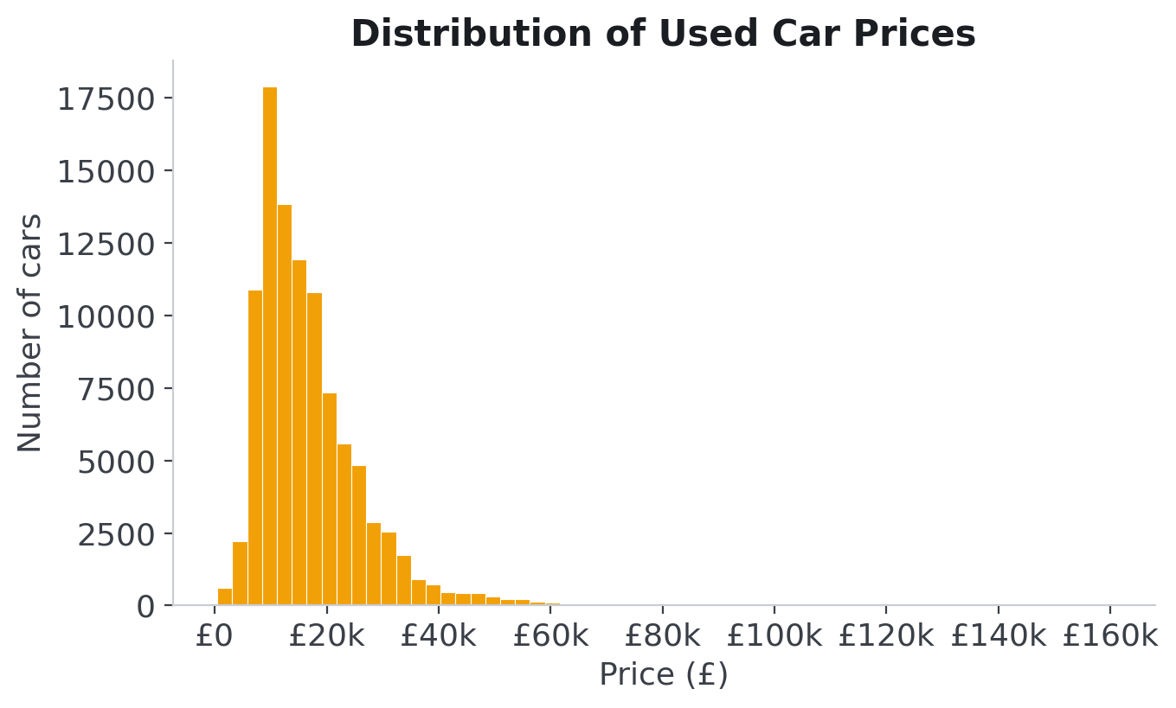
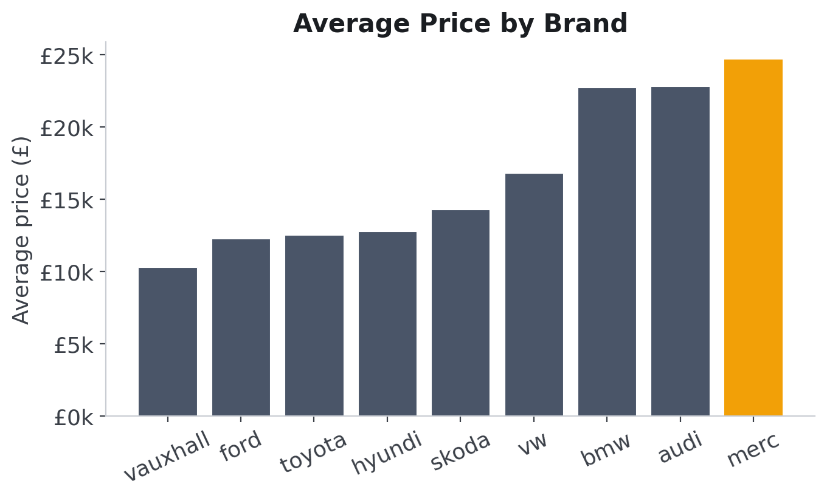
Exploratory Analysis — The Price Landscape
Prices are right-skewed — most cars sell for £5k–£25k, with a long tail of luxury models up to £160k. Average price varies widely by brand, with premium makes (Mercedes, BMW, Audi) commanding the highest prices.
Group 5 · Car Price Prediction Model
6
Notes:
Two views of price. On the left, the price distribution is right-skewed: most cars fall between about £5,000 and £25,000, with a long tail of expensive luxury cars stretching to £160,000. On the right, average price by brand — premium makes like Mercedes, BMW and Audi sit highest. This skew is why we later consider a log transform as a future improvement.

Slide 7

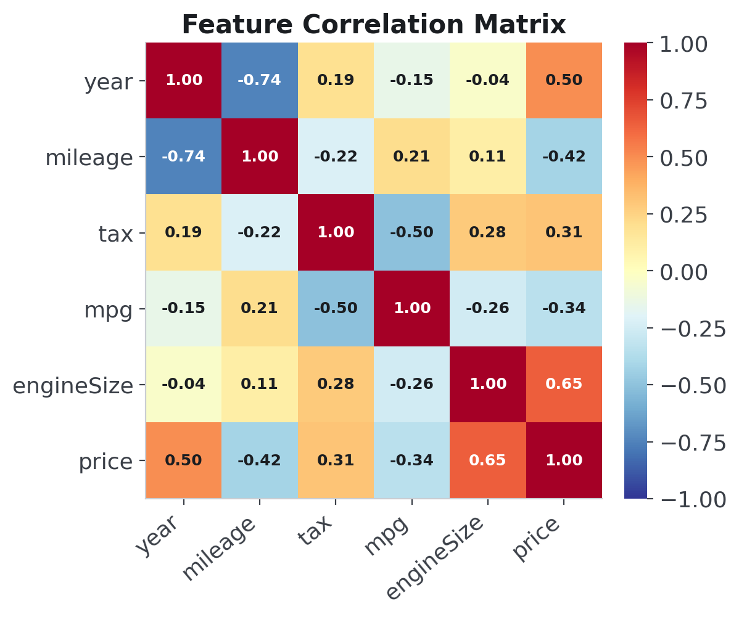
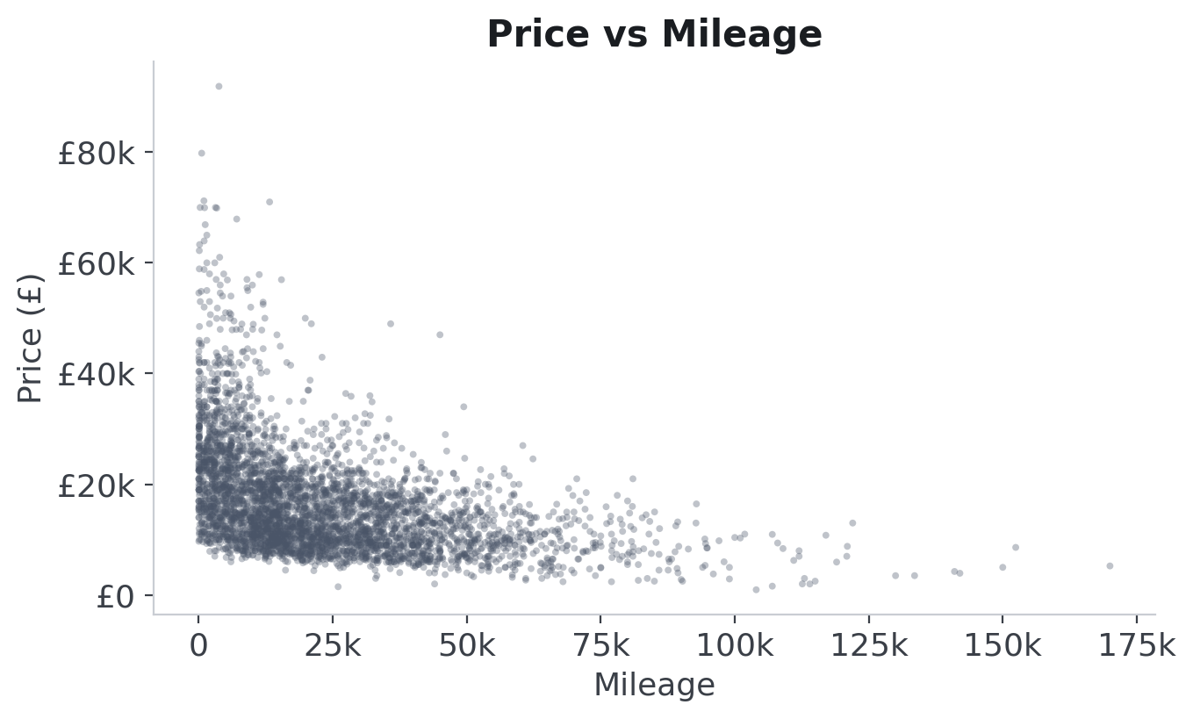
How Features Relate to Price
Newer cars (higher year) and larger engines push price up; higher mileage pulls it down. The correlation matrix confirms these relationships, guiding which features the model should rely on.
Group 5 · Car Price Prediction Model
7
Notes:
Now relationships. The correlation matrix on the left shows year and engine size are positively related to price, while mileage is negatively related. On the right, price versus mileage makes that concrete — as mileage climbs, price clearly falls. These sensible relationships give us confidence the data is sound and tell the model which features matter.

Slide 8
UP NEXT · PART 02
Methodology & Implementation
02
How we cleaned the data, engineered features, and trained our models.
Notes:
Thank you. I'll now take over the methodology — how we turned this raw data into a working model.

Slide 9





Methodology — Our ML Pipeline
A clean, repeatable pipeline takes the raw CSV files all the way to an evaluated model.
1
2
3
4
5
6
Load & Merge
9 brand files → one table
Clean
Remove duplicates & errors
Preprocess
Impute, scale, encode
Select Features
Keep the informative inputs
Train Models
3 regressors + 5-fold CV
Evaluate
Compare on unseen test data
Why a pipeline? Wrapping every step in one scikit-learn Pipeline means the exact same transformations are applied during training, cross-validation and testing — no data leakage, and the whole process is reproducible with a single call.
Group 5 · Car Price Prediction Model
9
Notes:
Our methodology follows a clean six-step pipeline: load and merge the nine brand files, clean the data, preprocess it, select features, train our models with cross-validation, and evaluate. Crucially, we wrap every step inside a single scikit-learn Pipeline. That guarantees the identical transformations are applied in training, cross-validation and testing — which prevents data leakage and makes the whole thing reproducible.

Slide 10



Data Preprocessing
Remove duplicates
1,475 duplicate listings dropped
preprocess.py
# numeric: fill gaps, then normalise
num = Pipeline([
('impute', SimpleImputer(
strategy='median')),
('scale', StandardScaler())])
# categorical: fill, then one-hot
cat = Pipeline([
('impute', SimpleImputer(
strategy='most_frequent')),
('onehot', OneHotEncoder(
handle_unknown='ignore'))])
# apply each to the right columns
prep = ColumnTransformer([
('num', num, num_features),
('cat', cat, cat_features)])
Fix invalid values
Impossible years & zero-priced rows removed
Impute missing values
Median (numeric) & most-frequent (categorical)
Scale numeric features
StandardScaler normalises the ranges
Encode categoricals
One-Hot for brand, transmission, fuel type
Group 5 · Car Price Prediction Model
10
Notes:
Preprocessing has five parts. We removed 1,475 duplicate listings and dropped impossible values like invalid years. We impute any missing values — median for numbers, most-frequent for categories. We scale the numeric features with StandardScaler so their ranges are comparable, and we one-hot encode the categorical features. The code on the right shows the two sub-pipelines combined in a ColumnTransformer, so each column type gets the right treatment automatically.

Slide 11
Feature Selection & Data Split
Features Used
Train / Test Split (80 / 20)
NUMERIC
year · mileage · engineSize · mpg · tax
CATEGORICAL
brand · transmission · fuelType
77,953
19,489
training cars (80%)
test (20%)
Why we excluded the 'model' column
Deliberate design decision: 'model' has 194 unique values — one-hot encoding it would inflate the feature space dramatically. Excluding it keeps the baseline robust and reproducible.
Acknowledged trade-off: variants within a brand (e.g. Audi A1 vs A6) are not distinguished, reducing prediction granularity.
Addressed in Future Work via target encoding, which captures model-level signal without feature explosion.
split.py
# 20% held out for honest testing
X_train, X_test, y_train, y_test = \
train_test_split(
X, y, test_size=0.2,
random_state=42)
Group 5 · Car Price Prediction Model
11
Notes:
For features we use five numeric columns — year, mileage, engine size, mpg and tax — and three categorical ones — brand, transmission and fuel type. We deliberately excluded the 'model' column: it has 194 unique values, and one-hot encoding it would inflate the feature space dramatically. This was a conscious design decision for a robust, reproducible baseline. The trade-off — reduced granularity within a brand — is acknowledged and addressed in our future work through target encoding. We then split the data 80/20 — 77,953 cars to train on and 19,489 held out for honest testing, with a fixed random seed so the split is reproducible.

Slide 12
Models & 5-Fold Cross-Validation
Linear Regression
Simple baseline — assumes a straight-line relationship between features and price.
train.py
# 5-fold cross-validation loop
kf = KFold(n_splits=5, shuffle=True,
random_state=42)
for name, model in models.items():
pipe = Pipeline([('prep', prep),
('model', model)])
scores = cross_val_score(
pipe, X_train, y_train,
cv=kf, scoring='r2')
Random Forest
Ensemble of decision trees; captures non-linear patterns and interactions.
Gradient Boosting
Trees built sequentially, each correcting the last — strong on tabular data.
5-fold cross-validation
trains and tests each model on 5 different splits, so the score reflects real performance — not one lucky split.
Group 5 · Car Price Prediction Model
12
Notes:
We compare three models: Linear Regression as a simple baseline, and two ensembles — Random Forest and Gradient Boosting — which capture non-linear patterns. The code shows our training loop: for each model we build a pipeline and run 5-fold cross-validation. That means each model is trained and tested on five different splits of the data, so the score we report is stable and trustworthy rather than the result of one lucky split.

Slide 13

Live Code Walkthrough
At this point we switch to the Python environment and run the full notebook live.
Load & merge
9 CSVs → 97,442 rows
EDA charts
generated live in the notebook
Preprocessing
pipeline runs before your eyes
Training & CV
3 models, real scores appear
car_price_prediction.ipynb — every cell is commented, runs top-to-bottom, and reproduces every number in this deck.
Group 5 · Car Price Prediction Model
13
Notes:
Before we discuss results, this is where we switch to the Python environment. We will run the notebook live: loading and merging the data, generating the EDA charts, running the preprocessing pipeline, and training the models with cross-validation. Every cell is commented, and every number you are about to see in the results section comes from this notebook.

Slide 14
UP NEXT · PART 03
Results & Discussion
03
Which model won, how accurate it is, and what actually drives price.
Notes:
Thanks. Now the part everyone's waiting for — the results.

Slide 15
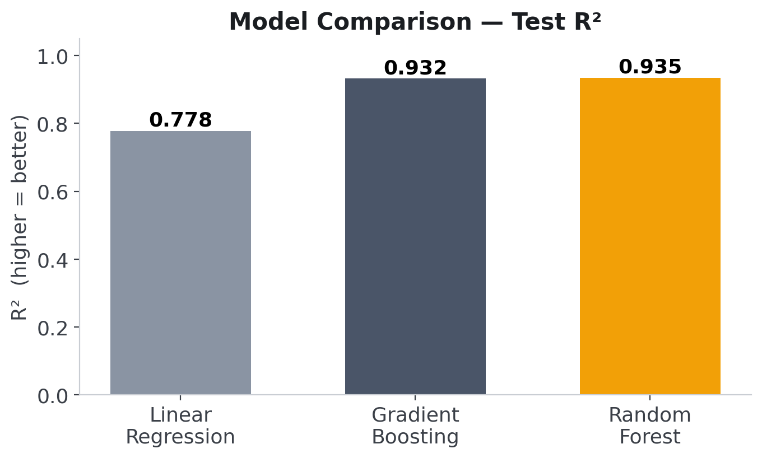
Results — Model Comparison
Model | CV R² | Test R² | RMSE | MAE
Linear Regression | 0.780 | 0.778 | £4,647 | £2,874
Gradient Boosting | 0.928 | 0.932 | £2,581 | £1,644
Random Forest ★ | 0.941 | 0.935 | £2,512 | £1,334
Random Forest wins. Highest R² and lowest error — and cross-validation agrees with the test set.
Group 5 · Car Price Prediction Model
15
Notes:
Here are the results. The baseline Linear Regression explains about 78% of price variation. Both ensembles jump to around 93%. Random Forest is the winner: a test R² of 0.935 and the lowest errors. Notice the cross-validation R² and the test R² agree closely for every model — that tells us the results are stable and we're not overfitting.

Slide 16

The Model in Action — Real Test Cars
Three unseen cars from the test set — the model never saw their prices during training.
Ford Focus
VW T-Roc
Mercedes SL Class
2015 · 31,974 mi · Manual · Petrol 1.0L
2018 · 23,385 mi · Manual · Diesel 2.0L
2019 · 1,000 mi · Semi-Auto · Petrol 2.0L
ACTUAL
PREDICTED
ACTUAL
PREDICTED
ACTUAL
PREDICTED
£8,498
£8,350
£20,489
£19,590
£32,299
£33,800
Across all 19,489 test cars the typical miss is £1,334 — these three are representative, not cherry-picked.
Group 5 · Car Price Prediction Model
16
Notes:
To make this concrete, here are three real cars from the test set. A 2015 Ford Focus: actual £8,498, we predicted £8,350 — off by £150. A VW T-Roc: off by £900. A nearly-new Mercedes SL: off by £1,500. These are representative of the typical £1,334 error across all 19,489 test cars — deliberately not cherry-picked best cases.

Slide 17
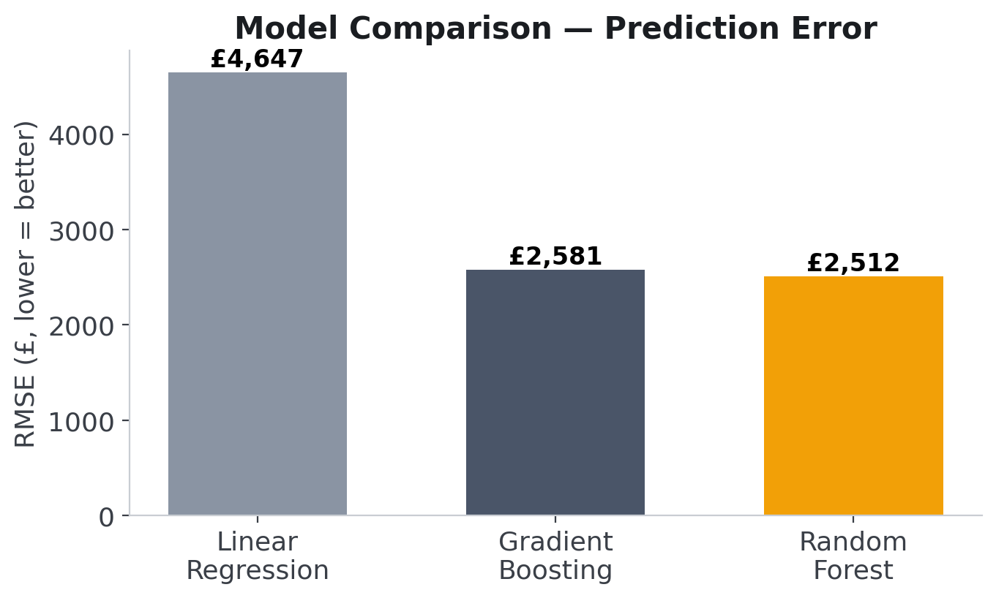
The Winning Model — Random Forest
0.935
Test R²
of price variation explained
£1,334
Mean Abs. Error
typical prediction is off by this
£2,512
RMSE
penalises the larger misses
Group 5 · Car Price Prediction Model
17
Notes:
Focusing on the winner. Random Forest explains 93.5% of the variation in price. Its mean absolute error is just £1,334 — so on a typical car, our prediction is only about £1,300 off. The RMSE of £2,512 is a bit higher because it penalises the occasional large miss on very expensive cars. For a model built on specs alone, that's genuinely strong accuracy.

Slide 18
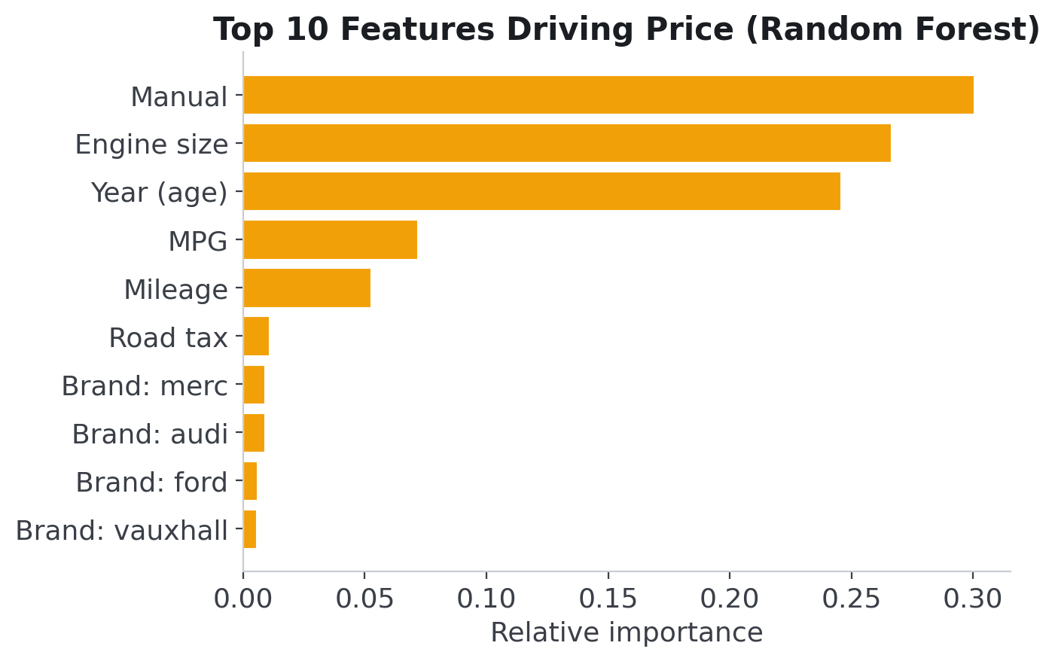
What Actually Drives the Price?
Transmission & engine size lead
Together 56.9% of total importance (30.3% + 26.6%)
Vehicle age follows closely
Year: 24.5% — mpg (7.2%) and mileage (5.2%) add smaller contributions
Consistent with domain intuition
The ranking mirrors how the used-car market actually prices vehicles
Note: all nine brand indicators combined account for only 4.4%. Impurity-based importances measure predictive contribution within this model — not causal effects.
Group 5 · Car Price Prediction Model
18
Notes:
Finally, what drives the price? These are the model's actual impurity-based feature importances. The manual-transmission indicator and engine size lead, together carrying 56.9 percent of total importance. Vehicle age follows at 24.5 percent, with fuel economy and mileage contributing 7.2 and 5.2 percent. This ranking is consistent with how the used-car market prices vehicles. One precise point for questions: all nine brand indicators combined account for only 4.4 percent — and importances measure predictive contribution within this model, not causal effects.

Slide 19
UP NEXT · PART 04
Conclusion & Future Work
04
What we achieved, what we learned, and where this could go next.
Notes:
Thank you. I'll close with our conclusions and future work.

Slide 20
Conclusion — Key Takeaways
Real data, full pipeline
Random Forest performed best
Merged and cleaned ~99k UK listings into 97,442 rows with a reproducible scikit-learn pipeline.
Test R² = 0.935 with a mean absolute error (MAE) of £1,334 — a strong, reliable predictor of used-car price.
Validated, not lucky
Price is driven by the car itself
5-fold cross-validation confirmed the results are stable and generalise to unseen cars.
Transmission, engine size and age explain most of the price — matching real-world intuition.
Group 5 · Car Price Prediction Model
20
Notes:
To conclude. We took around 99,000 real UK listings and built a complete, reproducible pipeline down to 97,442 clean rows. Random Forest was our best model, with a Test R-squared of 0.935 and a mean absolute error of £1,334. Five-fold cross-validation confirmed these results are stable. And we learned that price is driven mainly by the car itself — transmission, engine size and age — which matches real-world intuition.

Slide 21
Limitations & Reflection
An honest account of what our model cannot do — and why we accepted each trade-off.
One market, one period
The data covers nine UK brands, registered 1996–2020. The method transfers to any market, but the learned prices do not — a German model would need German listings.
Reduced granularity
Excluding the 194-value 'model' column means an Audi A1 and an A6 share the same brand signal, so within-brand differences are not fully captured.
Untuned by choice
We kept scikit-learn defaults to keep the baseline reproducible. Tuning would likely add accuracy — it is the first item in our future work, not an oversight.
Uneven coverage
Petrol and diesel dominate the data; electric and rare models are underrepresented, so predictions for them are less reliable.
Asking prices, not sale prices
Scraped listings show what sellers ask, not what buyers finally paid. Our model therefore predicts the market asking price.
Association, not causation
Feature importances show what the model relies on to predict — they do not prove that changing a feature would change a car's value.
Group 5 · Car Price Prediction Model
21
Notes:
Before our future work, we want to be explicit about the limits of what we built. First, the data is one market and one period — nine UK brands up to 2020; the method transfers anywhere, the learned prices do not. Second, excluding the model column costs us granularity within a brand. Third, we left the hyper-parameters at their defaults deliberately, to keep a reproducible baseline. Fourth, electric and rare cars are underrepresented, so predictions for them are weaker. Fifth, these are asking prices, not final sale prices. And finally, feature importances tell us what the model relies on — they are not causal claims. Knowing these limits is part of the result.

Slide 22
Future Improvements
The model works well — here is how we would push it further.
Add the car 'model'
Use target encoding to include model without exploding the feature space.
Tune hyper-parameters
Grid/random search on tree depth and count to squeeze out more accuracy.
Try XGBoost / LightGBM
Modern gradient-boosting libraries often edge out Random Forest on tabular data.
Log-transform the price
Handle the right-skew so the model treats cheap and luxury cars more evenly.
Deploy as a web app
Wrap the model in a simple interface so anyone can get a price estimate.
Add more brands & years
Broaden the data to generalise beyond these 9 UK makes.
Group 5 · Car Price Prediction Model
21
Notes:
Where could this go next? We'd add the specific car model back in using target encoding, tune the hyper-parameters, and try modern boosting libraries like XGBoost or LightGBM. Log-transforming the skewed price should help the model handle luxury cars. Longer term, we'd deploy it as a simple web app and add more brands and years so it generalises beyond these nine UK makes.

Slide 23

Sources & References
DATASET
100,000 UK Used Car Data set — A. Desai, Kaggle (2020)
kaggle.com/datasets/adityadesai13/used-car-dataset-ford-and-mercedes
LIBRARY
scikit-learn — Pedregosa et al., machine-learning models & pipeline
scikit-learn.org
LIBRARY
pandas — data loading, merging and cleaning
pandas.pydata.org
LIBRARY
NumPy — numerical computing
numpy.org
LIBRARY
Matplotlib — data visualisation
matplotlib.org
LANGUAGE
Python 3 — implementation language
python.org
All datasets and libraries are open-source and publicly available. Dataset used under its Kaggle licence for academic purposes.
Group 5 · Car Price Prediction Model
22
Notes:
For transparency, here are our sources. The dataset is the 100,000 UK Used Car set by Aditya Desai on Kaggle. We built everything in Python using scikit-learn for the models and pipeline, pandas and NumPy for data handling, and Matplotlib for the charts. All of these are open-source and publicly available, and the dataset is used under its Kaggle licence for academic purposes.

Slide 24
Thank You
Questions & Discussion
Group 5
SRH Berlin University of Applied Sciences · M.Sc. Big Data & Artificial Intelligence · Advanced Programming · 2026
Group 5 · Car Price Prediction Model
23
Notes:
That brings us to the end. Thank you for listening — we're happy to take any questions and discuss the model, the code or our results.

Slide 25
Questions
01
Why is a Random Forest better suited than a Linear Regression model for predicting used car prices?
02
How do the train/test split and 5-fold cross-validation work together to ensure our results are reliable and not simply due to chance?
03
Our feature importance analysis showed that the car's brand contributes only 4.4%. Why does the brand appear to matter so little when predicting a car's price?
Group 5 · Car Price Prediction Model
24
Notes:
Finally, three questions from our presentation. The first is about why we chose a tree-based model over a linear one. The second is about how we made sure our results are reliable. And the third is about our feature importance finding, which surprised us too — the brand contributes only 4.4 percent, because the specifications already carry most of that information.

